Slide 1
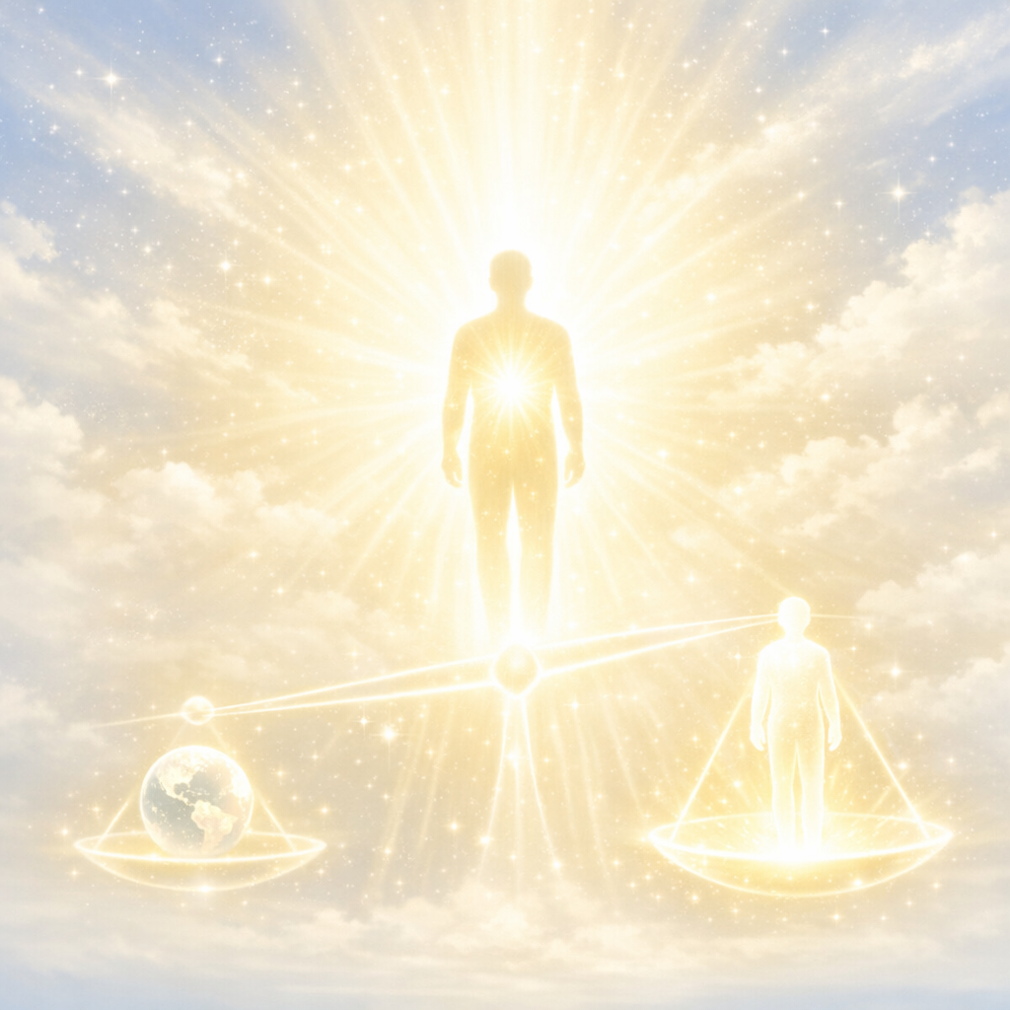
The Priceless Incomparable Eternal Value
God has Placed on Every
Human Soul
Matthew 16:26

Slide 2
Matthew 16:26 (NASB)
For what good will it do a person if he gains the whole world, but forfeits his soul? Or what will a person give in exchange for his soul?

Slide 3
Acts 8:32 (NASB)
Now the passage of Scripture which he was reading was this: "HE WAS LED LIKE A SHEEP TO SLAUGHTER; AND LIKE A LAMB THAT IS SILENT BEFORE ITS SHEARER, SO HE DOES NOT OPEN HIS MOUTH.

Slide 4
Matthew 10:28 (NLT)
Don't be afraid of those who want to kill your body; they cannot touch your soul. Fear only God, who can destroy both soul and body in hell.

Slide 5
God places an incalculable, infinite value on the human soul, regarding it as more precious than the entire material world. This value is demonstrated by the sacrifice of His Son, Jesus Christ, to redeem it, and is rooted in the soul being created in God's image, possessing an eternal, immortal nature.

Slide 6
Key Aspects of the Value God Places on the Soul Include:

Slide 7
The Price of Redemption:
The value of an item is what someone is willing to pay for it; God paid for the soul with the blood of Jesus, not with perishable things like gold or silver.

Slide 8
Created in God’s Image:
The soul is not just a part of the human, but the "real self" that is designed for eternal existence in God's likeness.

Slide 9
Irreplaceable and Unique:
No two souls are alike, making each individual irreplaceable to God.

Slide 10
Eternal Nature:
Because the soul lives forever (either in heaven or hell), it’s worth is not measured by earthly time or constraints.

Slide 11
Relentless Pursuit:
Parables like the lost sheep (Luke 15:3-7) highlight that God passionately desires and searches for every individual soul.

Slide 12
The Bible emphasizes that gaining the entire world is pointless if one loses their soul, reinforcing its unmatched, supreme value.
What is the Bible Definition of a Human Soul?

Slide 13
Genesis 2:7 (NASB)
Then the LORD God formed the man of dust from the ground, and breathed into his nostrils the breath of life; and the man became a living person.

Slide 14
According to the Bible:
The soul (in Hebrew; in Greek) is the living, conscious, and emotional core of a human being—the whole person created when God's breath of life joined with a physical body.

Slide 15
It represents the immaterial, immortal self, encompassing mind, will, and emotions, which continues after physical death.

Slide 16
Key Biblical Aspects of the Soul:
Definition: The soul represents the entire person or "living being" formed by the combination of body and breath.
Composition: It is often described as the seat of consciousness, desires, emotions, and intellectual capacity.

Slide 17
Scriptures define the human soul (nephesh in Hebrew; psyche in Greek) as the living, conscious, and emotional core of a person, often representing the whole being created by God. Key verses highlight its vulnerability to sin, its eternal value, and its need for spiritual restoration and salvation through God.

Slide 18
Creation and Definition of the Soul:
Genesis 2:7: Defines the soul as the living being formed when God breathed life into the physical body ("And man became a living soul/being").
Ezekiel 18:4: Establishes that all souls belong to God and the soul that sins shall die.

Slide 19
The Value and Condition of the Soul:
Matthew 16:26: Highlights the immense value of the soul, asking what it profits a man to gain the world but lose his soul.

Slide 20
Psalm 42:5: Describes the emotional life of the soul, with the Psalmist questioning why his soul is "cast down".
2 Peter 2:14: Mentions that souls can be unsteady, weak, or enticed by sin.

Slide 21
Restoration, Salvation, and Care of the Soul:
Psalm 23:3: Declares that the Lord is the shepherd who "restores my soul".
Psalm 19:7: Notes that the "law of the LORD is perfect, reviving the soul".

Slide 22
1 Peter 1:9: Focuses on the final outcome of faith as "the salvation of your souls".
1 Peter 4:19: Encourages believers to entrust their souls to a "faithful Creator".
Hebrews 6:19: Describes hope in God's promises as an "anchor for the soul".

Slide 23
The Soul and Salvation: Matthew 11:29: Jesus promises that coming to him will bring "rest for your souls".

Slide 24
Acts 27:22: Shows that in some contexts, the soul refers to the physical life of a person.
1 Peter 2:11: Warns to abstain from fleshly lusts that "wage war against your soul".

Slide 25
Distinction from Spirit/Body:
While sometimes used interchangeably with spirit, the soul is often viewed as the medium connecting the inner spirit (God-consciousness) with the physical body (world-consciousness).

Slide 26
Immortality & Accountability:
Unlike the physical body that returns to dust, the soul is considered immortal, enduring beyond death to face judgment or enter rest.

Slide 27
Spiritual Condition:
The Bible speaks of the soul as something that can be saved, lost, or sinful (Ezekiel 18:4, Matthew 16:26).

Slide 28
IN SUMMARY
The soul is the seat of personality and conscious life, representing the essence of a person designed to know and respond to God.

Slide 29
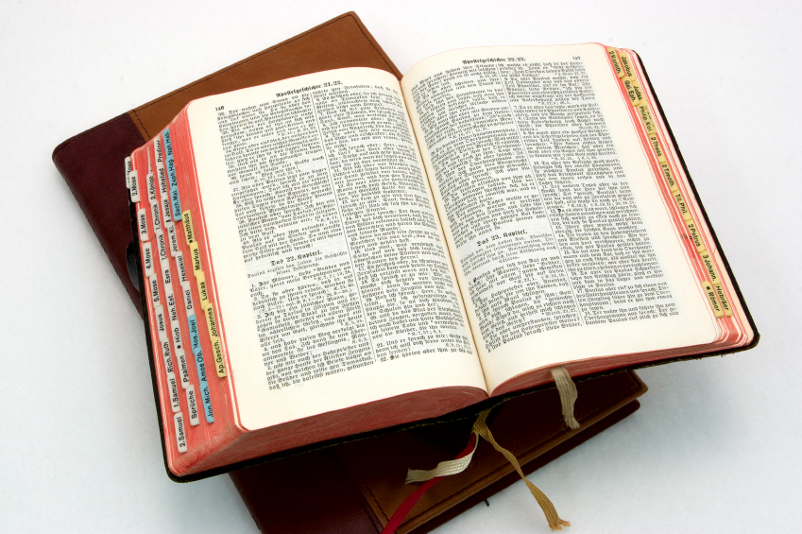
Hear: Romans 10:17
So then faith cometh by hearing, and hearing by the word of God.

Slide 30
Believe: Hebrews 11:6
But without faith it is impossible to please him: for he that cometh to God must believe that he is, and that he is a rewarder of them that diligently seek him.

Slide 31
Repent: Luke 13:3
I tell you, Nay: but, except ye repent, ye shall all likewise perish.

Slide 32
Confess: Matthew 10:32-33
32 Whosoever therefore shall confess me before men, him will I confess also before my Father which is in heaven.
33 But whosoever shall deny me before men, him will I also deny before my Father which is in heaven.

Slide 33
Baptize: Acts 22:16
And now why tarriest thou? arise, and be baptized, and wash away thy sins, calling on the name of the Lord.

